Slide 1
My Number Interactive Notebook
Name
Class
Teacher
Term 1 Semester 1
1

Slide 2
Warm-Up Questions
LHS – Simplify the Following:
3d + 4d
3 x 5v
16n ÷ 12
2c³ x 3c
24d³ ÷ 12d

Slide 3
Objective
By the end of this lesson, you will be able to use the Distributive Law to simplify basic algebraic expressions.

Slide 4
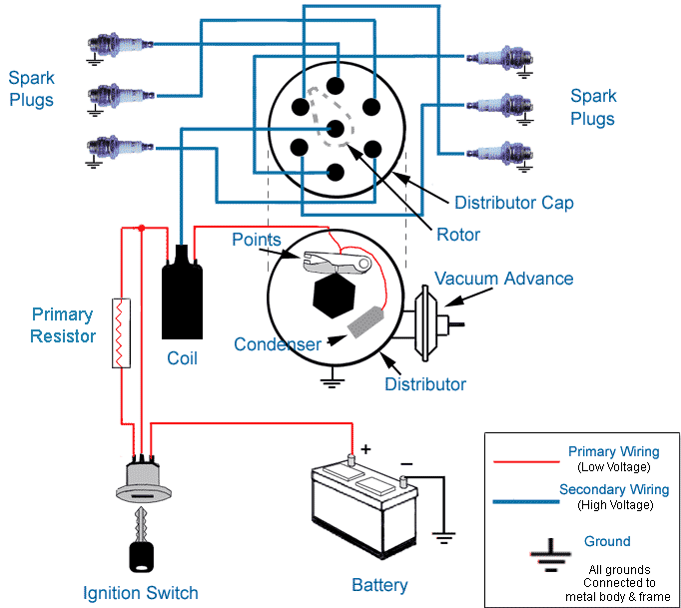
The Distributive Law
In a car the “Distributor” puts electric charge onto several different spark plugs. In maths we will distribute one item to multiply onto several other different items.
Image source: www.familycar.com

Slide 5
Mashup Math Video
Distributive Property – Sushi
https://www.youtube.com/watch?v=gw893STHN9w&t=1s

Slide 6

Several Ways to do our Maths
For the numeric expression below, there are three ways we can get to the answer: 2 (4 + 3) = 14
Using “BIMDAS”
Changing multiply to adding “lots of”
Using the “Distributive Law”

Slide 7
Use “BIDMAS” Order
When we apply “BIDMAS” to the expression below, we need to do “Brackets” before “Multiplying”.
2 (4 + 3) = 2 x (4+3) = 2 x (7) = 2 x 7 = 14

Slide 8
Change Multiply to Addition
Multiplying means having something several
times. (Eg. 3 x 5 means we have 3 lots of 5).
2 (4 + 3) = 2 x (4 + 3) = 2 lots of (4+3)
= 4+3 + 4+3 = 14

Slide 9


Distributive Law
What is the answer to 2(4 + 3) ?
2 (4 + 3) = 2x4 + 2x3 = 14 The “2” outside the brackets is multiplied onto everything that is inside the brackets.

Slide 10
Why Use Distributive Law ?
2(n + 3) = 2xn + 2x3 = 2n + 6 We cannot do Algebra expressions with BIMDAS because n+3 does not simplify to a whole number. So we have to use Distributive Law.

Slide 11

Why do we Expand Items?
2(n + 3) = 2n + 6 We “expand” 2(n+3) to become 2n + 6 so that we can solve for “n” in an equation like : 2n + 6 = 7 It is harder to solve: 2(n+3) = 7

Slide 12
24
7
30
Expanding Brackets
Date
EQ – How do I use the distributive law to expand expressions with brackets?
What is the distributive law?
The best place to start is with a mathematical expression:
a(b + c)
The distributive law is the process of distributing the number or variable on the outside of the brackets to every term inside the brackets. It looks like this:
a(b +c)
=
a x b
+
a x c
=
ab + ac

Slide 13
Distributive Law
24
7
30
Expanding Brackets
Date
EQ – How do I use the distributive law to expand expressions with brackets?
Example 1
2 (y + 3) = 2xy + 2x3 = 2y+6 The “2” outside the brackets multiplies onto all letters and numbers that are inside the brackets.

Slide 14
Distributive Law
24
7
30
Expanding Brackets
Date
EQ – How do I use the distributive law to expand expressions with brackets?
Example 2
4(4e - y) = 4x4e – 4xy = 16e – 4y The “4” outside the brackets is multiplied onto everything that is inside the brackets.

Slide 15
Distributive Law with Negative Integers
24
7
30
Expanding Brackets
Date
EQ – How do I use the distributive law to expand expressions with brackets?
Example 3
-6 (h - 3) = -6xh -6x-3 = -6h + 18 We need to be careful with the signs. - x + = - and - x - = +

Slide 16
Distributive Law with Indices
24
7
30
Expanding Brackets
Date
EQ – How do I use the distributive law to expand expressions with brackets?
Example 4
-9k (k - 2) = -9kxk -9kx-2 = -9k² + 18k We need to be careful with the signs. - x + = - and - x - = +

Slide 17




Now it’s your Turn

Slide 18
Which statement demonstrates the distributive property incorrectly?
3(x + y + z) = 3x + 3y + 3z
(a + b) c = ac + bc
5(2 + 3x) = 10 + 3x
6(3k - 4) = 18k - 24
Use the Exit Slip to Answer

